Slide 1
Intro to Data 3500

Slide 2
What can data do?
Describe the current state of an organization or process
Detect anomalous events
Diagnose the causes of events and behaviors
Predict future events

Slide 3
Why now?
We collect more data than ever before.
Suppose you buy a car from a dealership and fill out information.
That data is entered into databases from hundreds of dealerships.
It is easy to tie your car purchase to your social media and web browsing through your email address.
We now have a very complete picture of everyone who bought a car.
Age, likes, dislikes, friends, family
This information can be used to try to sell you specific insurance or advertise specific items to you.

Slide 4
The data science workflow
Collect data from many different sources.
Surveys, financial transactions, social media.
Data preparation.
Cleaning data, missing values, organize.
Explore and visualize.
Track changes in data over time, comparisons, outlier correction.
Experimentation and prediction.
Building a system to predict webpage usage, look at customer retention.

Slide 5
Case study: Fraud detection
Imagine you work at a bank and want to determine when a credit card purchase is fraudulent.
Collect information about each transaction, such as amount, date, location, purchase type.
You need labeled data to create a model (ie. Which transactions are valid and which are fraud).
This is known as training data and they are used to train an algorithm.
Feed new data into your model and it will classify a transaction as valid or fraudulent.

Slide 6
What do we need for machine learning?
A well-defined question.
What is the probability that this transaction is fraudulent?
A set of example data.
Old transactions labeled as fraudulent or valid.
A new set of data to use our algorithm on.
New credit card transactions.

Slide 7
Case study: Smart watch
Suppose you are trying to build a smart watch to monitor physical activity.
You want to auto detect walking and running.
Your watch has a sensor which tracks motion.
You can ask volunteers to wear your watch when walking or running, then collect that labeled data.
This becomes your training data.

Slide 8
Internet of Things (IoT)
Refers to gadgets that aren’t standard computers.
Smart watches
Internet-connected home security systems
Electronic toll collection systems
Building energy management systems

Slide 9
The roles of data science
Data Engineer
Data Analyst
Data Scientist
Machine Learning Scientist

Slide 10
Data Engineers
Information architects that control the flow of data.
Build data pipelines and storage solutions.
Maintain data access.
Focus on the first stage of the data science workflow.
Data collection and storage.
Data preparation.
Exploration and visualization.
Experimentation and prediction.

Slide 11
Data Engineering tools
SQL
Used to store and organize data.
Java, Scala, or Python
Programming languages to process data.
Shell
Command line to automate and run tasks.
Cloud computing
AWS, Azure, Google Cloud Platform.

Slide 12
Data Analyst
Perform simpler analyses that describe data.
Create reports and dashboards to summarize data.
Clean data for analysis.
Less programming and statistics than other roles.
Focus on the middle stages of the data science workflow.
Data collection and storage.
Data preparation.
Exploration and visualization.
Experimentation and prediction.

Slide 13
Data Analyst tools
SQL
Retrieve and aggregate data (obtain data from existing databases).
Spreadsheets (Excel or Google Sheets)
Simple analysis.
Business Intelligence Tools (Tableau, Power BI, Looker)
Dashboards and visualizations.
May use: Python or R
Clean and analyze data

Slide 14
Data Scientist
Strong background in statistics.
Run experiments and analyses for insight beyond just describing the data.
Traditional machine learning.
Focus on the last three stages of the data science workflow.
Data collection and storage.
Data preparation.
Exploration and visualization.
Experimentation and prediction.

Slide 15
Data Scientist tools
SQL
Retrieve and aggregate data.
Python and/or R
Data science libraries (ie. pandas)

Slide 16
Machine Learning Scientist
Predictions and extrapolations.
Use training data to classify larger more difficult data, such as images or creating chat bots.
Deep learning.
Image processing.
Natural language processing.
Focus on the last three stages of the data science workflow.
Data collection and storage.
Data preparation.
Exploration and visualization.
Experimentation and prediction (strong focus on prediction).

Slide 17
Machine Learning tools
Python and/or R
Machine learning libraries such as TensorFlow.

Slide 18
Recap
Data Engineer
Store and maintain data
SQL + Java/Scala/Python
Data Analyst
Visualize and describe data
SQL + BI Tools + Spreadsheets
Data Scientist
Gain insights from data
Python/R
Machine Learning Scientist
Predict with data
Python/R

Slide 19
Data collection and storage
Sources of data
Company data
Collected internally.
Helps make data driven decisions.
Open data
Free, available to anyone.
Can be used, shared, and built-on by anyone.

Slide 20
Company data
Web events
Survey data
Customer data
Logistics data
Financial transactions

Slide 21
Public data APIs
Application Programming Interface.
Request data over the internet from a third party.
Examples of Company APIs
Twitter
Wikipedia
Yahoo Finance
Many more

Slide 22
Public records
International organizations
World Bank, UN, WTO
National statistical offices
Censuses, surveys
Government agencies
Weather, environment, population
For the US, data.gov
For the EU, data.Europa.eu

Slide 23
Why care about data types?
Important later on when:
Storing the data
Visualizing/analyzing the data

Slide 24
Quantitative vs. qualitative data
Quantitative data
Deals with numbers.
Data can be measured.
Qualitative data
Deals with descriptions.
Data can be observed but not measured.

Slide 25
Quantitative vs. qualitative data
A refrigerator can contain both quantitative and qualitative measurements:
Quantitative
Is 60 inches tall.
Has 2 apples in it.
Costs $1000.
Qualitative
Is red.
Was built in Italy.
Smells like rotting food.

Slide 26
Other data types
Image data (pictures)
Text data (Yelp reviews)
Geospatial data (maps)
Network data (connections between people)
Can be a mix of quantitative and qualitative data.

Slide 27
Things to consider when storing data
Where/how are we going to store our data?
What type of data are we going to store?
How will we retrieve the data from storage?

Slide 28
Location: Parallel storage solutions
Local machine.
Parallel storage solutions (server on site).
Cloud storage (another company stores your data).

Slide 29
Types of data storage
Unstructured (Document Database)
Email
Text
Video and audio
Web pages
Social media
Tabular (Relational Database)

Slide 30
How do we scale?
More than one data source:
Public records
APIs
Databases
Different data types:
Unstructured data
Tabular data
Real-time streaming data (ie. Tweets)

Slide 31
Data pipeline
Moves data into defined stages.
Movement is automated.
Data continuously comes in and is automatically updated.
Automated collection and storage:
Scheduled hourly, daily, weekly, etc…
Triggered by an event.
Monitored with generated events.
For example, when 95% of capacity is reached, do something.
Necessary for big data projects with many sources.

Slide 32
Cast study: Smart home
Data sources, information, and frequency
Weather conditions – National Weather Service API – 30 minutes
Tweets in your area – Twitter API – Real-time stream
Indoor temperature – Smart home thermostat – 5 minutes
Status of lights – Smart light bulbs – 1 minute
Status of locks – Smart door locks – 15 seconds
Energy consumption – Smart meter – 7 days
We must extract all of the data from each source, but none of the data is at the same frequency.

Slide 33
Transform
With all the data coming in, how do we keep it organized and easy to use?
Joining data sources into one data set.
Converting data structures to fit database schemas.
Removing irrelevant data (maybe the number of followers a Twitter user has).
Data preparation and exploration do not happen here.

Slide 34
Automation
For example, every time we get a new Tweet, we must:
Transform the tweet
Store the tweet in the database

Slide 35
Why prepare data?
Real-life data is messy
Preparation is done to prevent:
Errors
Incorrect results
Biasing algorithms

Slide 36
Let’s start cleaning
 | Sara | Lis | Hadrien | Lis
Age | “27” | “30” |  | 30
Size | 1.77 | 5.58 | 1.80 | 5.58
Country | “Belgium” | “USA” | “FR” | “America”

Slide 37
Cleaned data
Reorganize data
Name | Age | Size | Country
Sara | “27” | 1.77 | “Belgium”
Lis | “30” | 5.58 | “USA”
Hadrien |  | 1.80 | “FR”
Lis | “30” | 5.58 | “America”

Slide 38
Cleaned data
Remove duplicates
Name | Age | Size | Country
Sara | “27” | 1.77 | “Belgium”
Lis | “30” | 5.58 | “USA”
Hadrien |  | 1.80 | “FR”

Slide 39
Cleaned data
Unique ID – what if there is another Lis and they are not actually duplicates?
ID | Name | Age | Size | Country
0 | Sara | “27” | 1.77 | “Belgium”
1 | Lis | “30” | 5.58 | “USA”
2 | Hadrien |  | 1.80 | “FR”

Slide 40
Cleaned data
Homogeneity – what is going on with the size column?
Europe uses the metric system, the USA uses feet.
Transform our data to be the same units
ID | Name | Age | Size | Country
0 | Sara | “27” | 1.77 | “Belgium”
1 | Lis | “30” | 1.70 | “USA”
2 | Hadrien |  | 1.80 | “FR”

Slide 41
Cleaned data
Homogeneity – what is going on with the country column?
“USA” and “FR” represent abbreviations.
“Belgium” is the full name.
ID | Name | Age | Size | Country
0 | Sara | “27” | 1.77 | “BE”
1 | Lis | “30” | 1.70 | “USA”
2 | Hadrien |  | 1.80 | “FR”

Slide 42
Cleaned data
Data types – age is encoded as text as indicated by the “ “.
Transform variable types to match what they represent.
ID | Name | Age | Size | Country
0 | Sara | 27 | 1.77 | “BE”
1 | Lis | 30 | 1.70 | “USA”
2 | Hadrien |  | 1.80 | “FR”

Slide 43
Cleaned data
Missing values – very common and occur for various reasons.
Data entry, error, valid missing data.
Solutions include
Impute, drop, keep with missing value.
Let us take the mean age value and apply it to Hadrien.
ID | Name | Age | Size | Country
0 | Sara | 27 | 1.77 | “BE”
1 | Lis | 30 | 1.70 | “USA”
2 | Hadrien | 28.5 | 1.80 | “FR”

Slide 44
What is EDA?
Exploratory data analysis:
Exploring the data
Formulating hypotheses
Assessing characteristics
Visualizing

Slide 45
Let’s drive right in
Dataset 1 |  |  | Dataset 2 |  |  | Dataset 3 |  |  | Dataset 4
x | y |  | x | y |  | x | y |  | x | y
10.0 | 8.04 |  | 10.0 | 9.14 |  | 10.0 | 7.46 |  | 8.0 | 6.58
8.0 | 6.95 |  | 8.0 | 8.14 |  | 8.0 | 6.77 |  | 8.0 | 5.76
13.0 | 7.58 |  | 13.0 | 8.74 |  | 13.0 | 12.74 |  | 8.0 | 7.71
9.0 | 8.81 |  | 9.0 | 8.77 |  | 9.0 | 7.11 |  | 8.0 | 8.84
11.0 | 8.33 |  | 11.0 | 9.26 |  | 11.0 | 7.81 |  | 8.0 | 8.47
14.0 | 9.96 |  | 14.0 | 8.10 |  | 14.0 | 8.84 |  | 8.0 | 7.04
6.0 | 7.24 |  | 6.0 | 6.13 |  | 6.0 | 6.08 |  | 8.0 | 5.25
4.0 | 4.26 |  | 4.0 | 3.10 |  | 4.0 | 5.39 |  | 19.0 | 12.50
12.0 | 10.84 |  | 12.0 | 9.13 |  | 12.0 | 8.15 |  | 8.0 | 5.56
7.0 | 4.82 |  | 7.0 | 7.26 |  | 7.0 | 6.42 |  | 8.0 | 7.91
5.0 | 5.68 |  | 5.0 | 4.74 |  | 5.0 | 5.73 |  | 8.0 | 6.89

Slide 46
What can you tell about the data?
Probably almost nothing from just looking at it.
Surprise….
Identical mean and variance for x
Identical mean and variance for y
Identical correlation coefficient
Identical linear regression equation

Slide 47
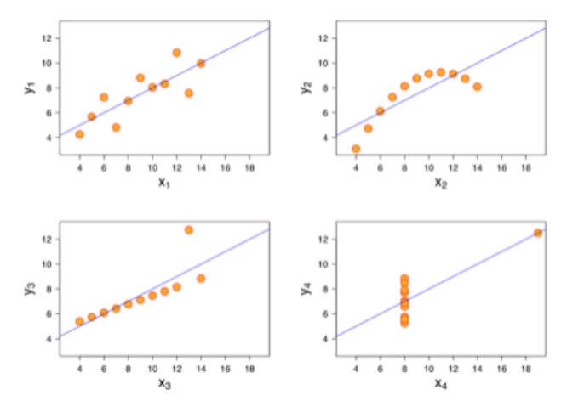
Are the value actually similar?

Slide 48
SpaceX Launches – knowing your data
Flight number (number)
Date (datetime)
Time (UTC) (datetime)
Booster version (text)
Launch site (text)
Payload (text)
Payload mass (kg) (number)
Orbit (text)
Customer (text)
Mission outcome (text)
Landing outcome (text)

Slide 49
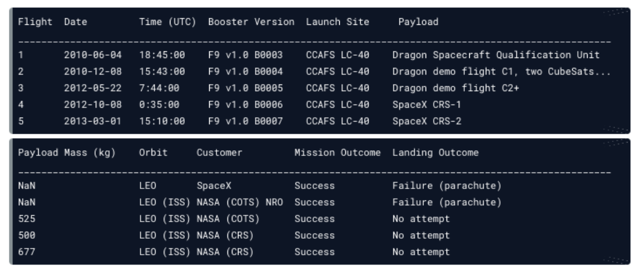
SpaceX data

Slide 50
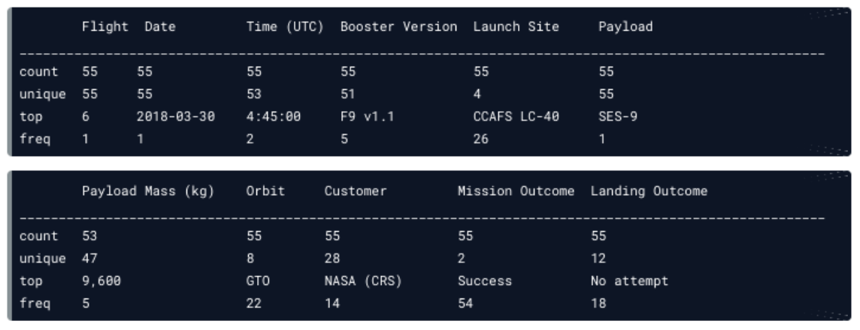
Descriptive statistics

Slide 51
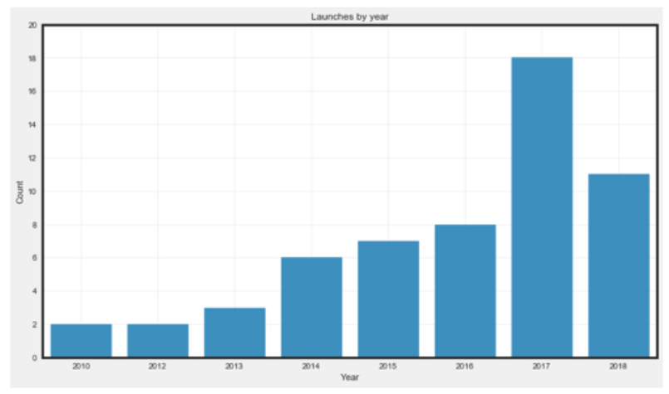
Visualize

Slide 52
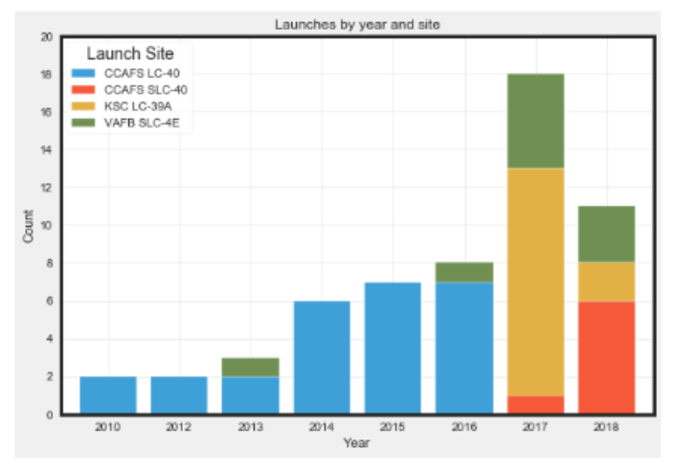
Ask more questions

Slide 53
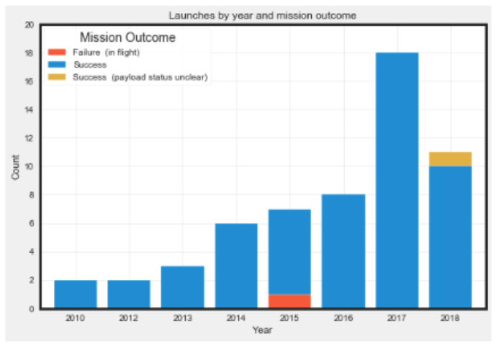
Ask more questions

Slide 54
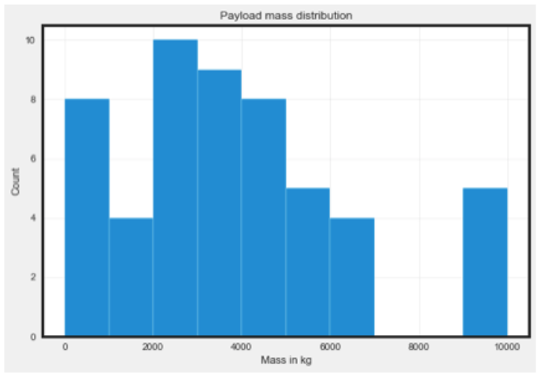
Outliers

Slide 55
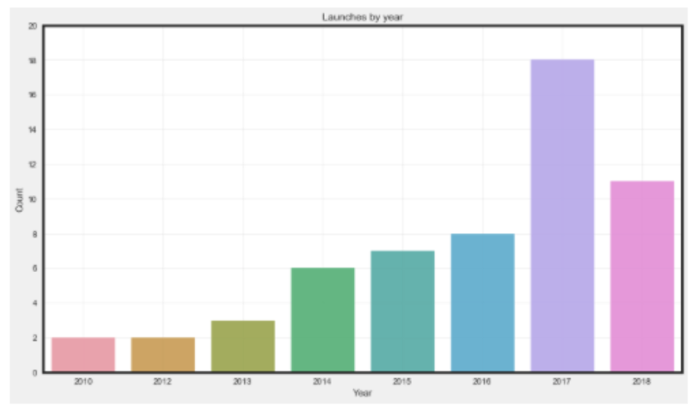
Use color purposefully

Slide 56
What are experiments in data science?
Experiments help drive decisions and draw conclusions
Form a question
Form a hypothesis
Collect data
Test the hypothesis with a statistical test
Interpret the results
Some examples include
A/B testing, time series forecasting, machine learning, and clustering

Slide 57
Case study: Which title is better?
A – Become an expert Data Scientist with this one weird trick!
B – You won’t believe these tips for becoming a Data Scientist!
Form a question: Does title A or title B result in more clicks?
Form a hypothesis: Title A and title B result in the same amount of clicks.
Collect data: 50% of users will see A, 50% of users will see B.
Track click-through rate until sample size is reached.

Slide 58
Case study: Which title is better?
Test the hypothesis with a statistical test: Is the difference in titles’ click-through rates significant?
Interpret results:
Choose a title
Ask more questions and design another experiment
This is known as A/B testing.

Slide 59
What is supervised machine learning?
Machine learning: predictions from data
Supervised machine learning: predictions from data with labels and features
Recommendation systems
Diagnosing biomedical images
Recognizing hand-written digits
Predicting customer churn

Slide 60
Case study: churn prediction
How likely is a customer to (a) cancel a subscription or (b) stay subscribed?
We need training data: historical customer data who make both decision (a) or (b).
We need features of each customer to help predict the outcome: age, gender, date of last purchase, date of last visit, location, salary, etc…

Slide 61
Case study: churn prediction
Suppose we want to know if Sally is going to remain a subscriber or churn.
We can collect features (or characteristics) about Sally to input into our trained model.
Our model will use Sally’s features to predict her most likely action.

Slide 62
This course
The focus of this course will be…
Data collection
Data processing
Data exploration
Data visualization
Feature engineering

